Slide 1
AWS DynamoDB
December 2019

Slide 2
Agenda
NoSQL Database Concept
Common distributed Architecture of NoSQL Database
DynamoDB Basics
DynamoDB vs RDBMS
Core Components :
Primary Key
Partition keys exercise
Secondary Index
Datatypes
DynamoDB Streams
DynamoDB APIs
DynamoDB APIs - Examples
Consistency Model
Provisioned Throughput
Cost Calculation based on Provisioned Throughput
Partitions
Security
DynamoDB Anti Pattern

Slide 3
NoSQL Database Concept
NoSQL database stands for "Not Only SQL" or "Not SQL.“
NoSQL is a non-relational DMS, that does not require a fixed schema, avoids joins, and is easy to scale. NoSQL database is used for distributed data stores. NoSQL is used for Big data and real-time web apps.
The concept of NoSQL databases became popular with Internet giants like Google, Facebook, Amazon, etc. who deal with huge volumes of data. The system response time becomes slow when you use RDBMS for massive volumes of data.
Features of NoSQL:
Non-Relational
Schema-free
Distributed
Types of NoSQL:
Key-value Pair Based
Column-oriented Graph
Graphs based
Document-oriented
Most of the NoSQL database support Eventual Consistency ->
The term "eventual consistency" means to have copies of data on multiple machines to get high availability and scalability. Thus, changes made to any data item on one machine has to be propagated to other replicas.
Data replication may not be instantaneous as some copies will be updated immediately while others in due course of time. These copies may be mutually, but in due course of time, they become consistent. Hence, the name eventual consistency.

Slide 4
Common distributed Architecture of NoSQL Database
Almost all NoSQL database support a distributed architecture as follows-
Shard 1
Shard 2
Shard 3
Shard 4
Config Server
Master Node
Client

Slide 5
DynamoDB Basics
DynamoDB is a NoSQL database in AWS cloud environment which is fully managed by Amazon.
It is highly available with replication across 3 AZ.
Scale to massive workload and distributed database.
DynamoDB we can store 100 TB of and can expect great performance.
DynamoDB is schemaless
Supports both document and key-value store.
High performance with single digit millisecond latency for every retrieval.
Low cost and having auto scaling capabilities.
DynamoDB is made up of tables, you don’t need to create database explicitly.
Each table can have infinite number of items where each item is considered as row.
Maximum size of an item is 400 KB.

Slide 6
DynamoDB vs RDBMS
Characteristic | Relational Database Management System (RDBMS) | Amazon DynamoDB
Optimal Workloads | Ad hoc queries; data warehousing; OLAP (online analytical processing). | Web-scale applications, including social networks, gaming, media sharing, and Internet of Things (IoT).
Data Model | The relational model requires a well-defined schema, where data is normalized into tables, rows, and columns. | DynamoDB is schemaless. Every table must have a primary key to uniquely identify each data item. DynamoDB can manage structured or semistructured data, including JSON documents.
Consistency Model | RDMS follows ACID property. It allows only consistent transaction. | DynamoDB allows both strong and eventual consistent read.
Performance | Relational databases are optimized for storage, so performance generally depends on the disk subsystem. Developers and database administrators must optimize queries, indexes, and table structures in order to achieve peak performance. | DynamoDB is optimized for compute, so performance is mainly a function of the underlying hardware and network latency.
Scaling | It can be scalled up with faster hardware. It is also possible for database tables to span across multiple hosts in a distributed system, but this requires additional investment. | DynamoDB is designed to scale out using distributed clusters of hardware. This design allows increased throughput without increased latency.

Slide 7
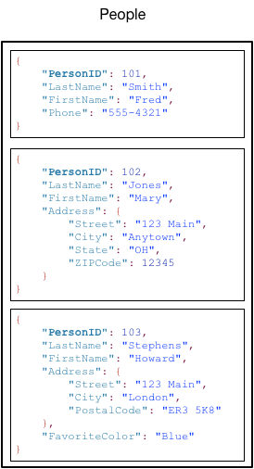
Core Components :
In DynamoDB, tables, items, and attributes are the core components.
Table: Similar to other database systems, DynamoDB stores data in tables. A table is a collection of data.
Items: Each table contains zero or more items. An item is a group of attributes that is uniquely identifiable among all of the other items.
Attributes: Each item is composed of one or more attributes. An attribute is a fundamental data element, something that does not need to be broken down any further.
Note the following about the People table:
Each item in the table has a unique identifier, or primary key. In the People table, the primary key consists of one attribute (PersonID).
People table is schemaless, which means that neither the attributes nor their data types need to be defined beforehand. Each item can have its own distinct attributes.
Attributes can be either scalar, which means they can have only one value or nested attribute (Address).
DynamoDB supports nested attributes up to 32 levels deep.

Slide 8
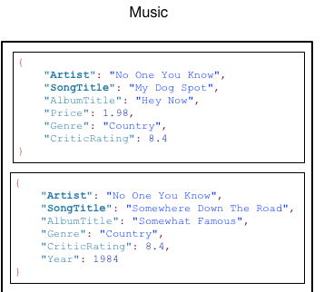
Primary Key
Primary key uniquely identifies each item in the table, so that no two items can have the same key. While creating a table, in addition to the table name, must specify the primary key of the table.
DynamoDB supports two different kinds of primary keys:
Partition key (Hash key) – A simple primary key, composed of one attribute known as the partition key. It has to diverse enough that data is distributed.
Partition key and sort key (Hash key + Range key) – Referred to as a composite primary key, this type of key is composed of two attributes. The first attribute is the partition key, and the second attribute is the sort key. The combination must be unique.
In Previous example PersonID is the example of Partition Key
Here in Music table Artist, SongTitle together form Primary Key where Artist is the Partition Key and SongTItile is the Sort Key.

Slide 9
Partition keys exercise
You need think about before choosing a good partition key. Always remember Partition key has to be distributed.
Take an example of People table. While designing the People table first you have to think –
What is the partition key to maximize the data distribution?
PersonId
LastName
FirstName
PersonId has the highest cardinality – so it is a good candidate of Partition key.
For FirstName/LastName data can be more skewed.

Slide 10
Secondary Index
You can create one or more secondary indexes on a table. A secondary index lets you query the data in the table using an alternate key, in addition to queries against the primary key.
After you create a secondary index on a table, you can read data from the index in much the same way as you do from the table.
DynamoDB supports two kinds of indexes:
Global secondary index – An index with a partition key and sort key that can be different from those on the table.
Local secondary index – An index that has the same partition key as the table, but a different sort key.
Each table in DynamoDB has a limit of 20 global secondary indexes (default limit) and 5 local secondary indexes per table.
When you create an index, you specify which attributes will be copied, from the base table to the index. At a minimum, DynamoDB projects the key attributes from the base table into the index.
Global secondary index can be created after table creation but Local secondary index cannot be created.

Slide 11
Datatypes
DynamoDB supports many different data types for attributes within a table. They can be categorized as follows:
Scalar Types – A scalar type can represent exactly one value. The scalar types are number, string, binary, Boolean, and null.
Document Types – A document type can represent a complex structure with nested attributes, such as you would find in a JSON document. The document types are list and map.
Set Types – A set type can represent multiple scalar values.
You can use DynamoDB Streams together with other AWS services, like – Lambda which will be triggered automatically when triggering event occur.
When you create a table or a secondary index, you must specify the names and data types of each primary key attribute (partition key and sort key). Furthermore, each primary key attribute must be defined as type string, number, or binary.
As DynamoDB is schemaless, other than the primary key attributes, you don't have to define any attributes or data types when you create tables. By comparison, relational databases require you to define the names and data types of each column when you create a table.

Slide 12
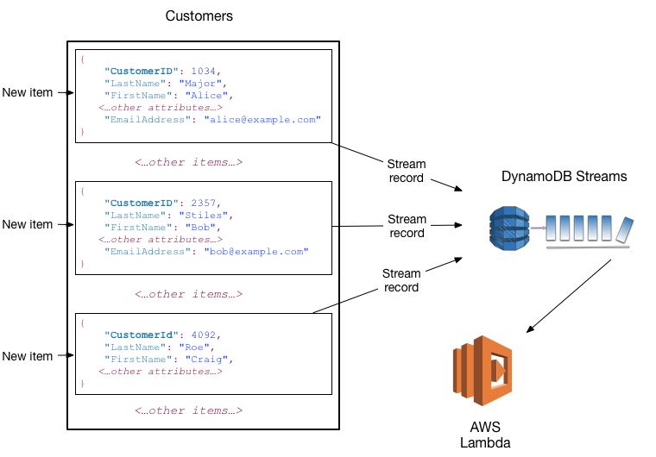
DynamoDB Streams
DynamoDB Streams is an optional feature that captures data modification events in DynamoDB tables. The data about triggering events appear in the stream in near-real time, and in the order that the events occurred.
Each event is represented by a stream record.
You enable a stream on a table.
Each stream record also contains the name of the table, the event timestamp, and other metadata.
Stream records have a lifetime of 24 hours; after that, they are automatically removed from the stream.
You can use DynamoDB Streams together with other AWS services, like – Lambda which will be triggered automatically when triggering event occur.
DynamoDB Streams writes a stream record whenever one of the following events occurs:
A new item is added to the table: The stream captures an image of the entire item, including all of its attributes.
An item is updated: The stream captures the "before" and "after" image of any attributes that were modified in the item.
An item is deleted from the table: The stream captures an image of the entire item before it was deleted.

Slide 13
DynamoDB APIs
DynamoDB can accessed directly from AWS web console or using APIs.
Table level operations –
CreateTable – Creates a new table. Optionally, you can create one or more secondary indexes, and enable DynamoDB Streams for the table.
ListTables – Returns the names of all of your tables in a list.
UpdateTable – Modifies the settings of a table or its indexes, creates or removes new indexes on a table.
DeleteTable – Removes a table and all of its dependent objects from DynamoDB.

Slide 14
DynamoDB APIs - Examples
CreateTable:
import boto3 #AWS Python SDK
dynamodb = boto3.resource('dynamodb', region_name='us-west-2‘)
table = dynamodb.create_table(
TableName='Movies',
KeySchema=[
{
'AttributeName': 'year',
'KeyType': 'HASH' #Partition key
},
{
'AttributeName': 'title',
'KeyType': 'RANGE' #Sort key
}
],
AttributeDefinitions=[
{
'AttributeName': 'year',
'AttributeType': 'N'
},
{
'AttributeName': 'title',
'AttributeType': 'S'
},
],
ProvisionedThroughput={
'ReadCapacityUnits': 10, #RCU
'WriteCapacityUnits': 10 #WCU
}
)
print("Table status:", table.table_status)

Slide 15
DynamoDB APIs – Contd.
You create/manage an item in DynamoDB table either by using AWS web console or programmatically by using APIs.
Data level operations –
Creating Data –
Reading Data
PutItem – Writes a single item to a table. You must specify the primary key attributes, but you don't have to specify other attributes.
BatchWriteItem – Writes up to 25 items to a table. This is more efficient than calling PutItem multiple times because your application only needs a single network round trip to write the items.
GetItem – Retrieves a single item from a table. You must specify the primary key for the item that you want. You can retrieve the entire item, or just a subset of its attributes.
BatchGetItem – Retrieves up to 100 items from one or more tables. This is more efficient than calling GetItem multiple times.
Query – Retrieves all items that have a specific partition key. You must specify the partition key value.
Scan – Retrieves all items in the specified table or index.

Slide 16
DynamoDB APIs – Contd.
Updating Data
Deleting Data
UpdateItem – Modifies one or more attributes in an item. You must specify the primary key for the item that you want to modify.
DeleteItem – Deletes a single item from a table. You must specify the primary key for the item that you want to delete.
BatchWriteItem – Deletes up to 25 items from one or more tables.

Slide 17
DynamoDB APIs - Examples – Contd.
Create Data:
The following is an example of movie data (moviedata.json):
{
"year" : 2013,
"title" : "Turn It Down, Or Else!",
"info" : {
"directors" : [
"Alice Smith",
"Bob Jones"
],
"release_date" : "2013-01-18T00:00:00Z",
"rating" : 6.2,
"genres" : [
"Comedy",
"Drama"
],
"actors" : [
"David Matthewman",
"Ann Thomas",
"Jonathan G. Neff"
]
}
}
Now load the sample data into “Movies” table:
import boto3
import json
import decimal
dynamodb = boto3.resource('dynamodb', region_name='us-west-2')
table = dynamodb.Table('Movies')
with open("moviedata.json") as json_file:
movies = json.load(json_file, parse_float = decimal.Decimal)
for movie in movies:
year = int(movie['year'])
title = movie['title']
info = movie['info']
print("Adding movie:", year, title)
table.put_item(
Item={
'year': year,
'title': title,
'info': info,
}
)

Slide 18
DynamoDB APIs - Examples – Contd.
Read Data:
Read the data from DynamoDB table “Movies” which was inserted in last example:
import boto3
import json
from botocore.exceptions import ClientError
dynamodb = boto3.resource("dynamodb", region_name='us-west-2')
table = dynamodb.Table('Movies')
title = "Turn It Down, Or Else!"
year = 2013
try:
response = table.get_item(
Key={
'year': year,
'title': title
}
)
except ClientError as e:
print(e.response['Error']['Message'])
else:
item = response['Item']
print("GetItem succeeded...")

Slide 19
DynamoDB APIs - Examples – Contd.
Update Data:
Update the data in DynamoDB table “Movies”:
import boto3
import json
import decimal
dynamodb = boto3.resource('dynamodb', region_name='us-west-2')
table = dynamodb.Table('Movies')
title = "The Big New Movie"
year = 2015
response = table.update_item(
Key={'year': year,
'title': title
},
UpdateExpression="set info.rating = :r, info.actors=:p",
ExpressionAttributeValues={
':r': decimal.Decimal(5.5),
':p': ["Larry", "Moe", "Curly"]
},
ReturnValues="UPDATED_NEW"
)
print("UpdateItem succeeded")
Existing data:
{ year: 2015,
title: "The Big New Movie",
info: {
plot: "Nothing happens at all.",
rating: 0
}
}
Expected updated data:
{ year: 2015,
title: "The Big New Movie",
info: {
plot: "Nothing happens at all.",
rating: 5.5,
actors:[“Larry”, ”Moe”, ”Curly”]
}
}
Notice That:
Item which is existing got updated
Item which was not existing got appended automatically

Slide 20
DynamoDB APIs - Examples – Contd.
Query Data:
You can use the query method to retrieve data from a table. You must specify a partition key value.
Query all the movies released in a particular year:
import boto3
import json
from boto3.dynamodb.conditions import Key, Attr
dynamodb = boto3.resource('dynamodb', region_name='us-west-2')
table = dynamodb.Table('Movies')
print("Movies from 2013")
response = table.query(
KeyConditionExpression=Key('year').eq(2013)
)
for i in response['Items']:
print(i['year'], ":", i['title'])

Slide 21
DynamoDB APIs - Examples – Contd.
Scan Data:
The scan method reads every item in the entire table and returns all the data in the table. You can provide an optional filter_expression so that only the items matching your criteria are returned. However, the filter is applied only after the entire table has been scanned.
The following program scans the entire Movies table:
import boto3
import json
import decimal
from boto3.dynamodb.conditions import Key, Attr
dynamodb = boto3.resource('dynamodb', region_name='us-west-2')
table = dynamodb.Table('Movies')
fe = Key('year').between(2013, 2015)
pe = "#yr, title, info.rating"
# Expression Attribute Names for Projection Expression only.
ean = { "#yr": "year", }
esk = None
response = table.scan(
FilterExpression=fe,
ProjectionExpression=pe,
ExpressionAttributeNames=ean
)
for itm in response['Items']:
print(‘Movie ’ + itm[“title”] + ‘ released in the year:’ + itm[“year”])

Slide 22
Consistency Model
When your application writes data to a DynamoDB table that data is eventually consistent across all storage locations, usually within one second or less.
DynamoDB supports two types of consistency reads –
Eventual Consistency (Default) - When you read data from a DynamoDB table, the response might not reflect the results of a recently completed write operation. The response might include some stale data. If you repeat your read request after a short time, the response should return the latest data.
Strong Consistency - When you request a strongly consistent read, DynamoDB returns a response with the most up-to-date data, reflecting the updates from all prior write operations that were successful.
However, this consistency comes with some disadvantages:
A strongly consistent read might not be available if there is a network delay or outage.
Strongly consistent reads may have higher latency than eventually consistent reads.
Strongly consistent reads are not supported on global secondary indexes.
Strongly consistent reads use more throughput capacity than eventually consistent reads.
Read operations (such as GetItem, Query and Scan) provide a Consistent Read.

Slide 23
Provisioned Throughput
A DynamoDB table must have provisioned read and write capacity units. You need mention that at time of table creation.
Read Capacity Units(RCU): Throughput for reads.
Write Capacity Units(WCU): Throughput for writes
If you are not in a position to figure out RCU/WCU for your DynamoDB table in advance and want to evolve up & down based on the write and read patterns of DynamoDB table then you can go for Auto-Scaling option.
Throughput can be exceeded temporarily using “burst credit”.
WCU represent 1 write/sec for an item up to 1 KB in size.
Example: you write 6 objects per second of 4.5 kb each
then you need 6*5 = 30 WCU (4.5 gets rounded to upper kb)
RCU represents 1 strongly consistent read/sec, or 2 eventual consistent read/sec for an item up to 4 kb in size.
Example#1: 8 strongly consistent reads per second of 4 kb each
then you need 8*(4/4) = 8 RCU required
Example#2: 10 eventually consistent reads per second of 16 kb each
then you need (10/2)*(16/4) = 20 RCU

Slide 24
Cost Calculation based on Provisioned Throughput
Pricing for Provisioned Throughput type:
For per RCU for each strongly consistent read $0.00013/hr
For per WCU $0.00065/hr
First 25 GB data is free per month, $0.25/GB-month thereafter
Example:
Application need 1 million writes and 1 million strongly consistent reads per day where each element size is 1 kb with 28Gb of data as storage. Then what will be the cost to maintain this DynamoDB table in AWS?
First calculate required read and per second -> 1000000/24(hr)/60(min)/60(sec) = 11.6
That means, 11.6 read and 11.6 write / sec is required.
As DynamoDB 1 WCU 1 write/sec for an item up to 1 KB in size so we need 12 WCU. Which will cost ($0.00065 * 12 * 24) = $0.1872/day
Similarly for strongly consistent read total required read capacity unit – 12 * (1/4) = 3 RCU which will cost ($0.00013 * 3 * 24) = $0.00936/day
For 28 GB data
25 GB is free
so 3 GB is chargeable = ($0.25 * 3) = $0.75/30 = $0.025/day
Therefore total cost per month -> ($0.1872 + $0.00936 + $0.025) = $0.2215 * 30 = $6.65 / month

Slide 25
Partitions
When we create a DynamoDB table it starts with one partition first.
Each partition has a limit-
Max 3000 RCU/1000 WCU
Can store max 10GB data
While populating a DynamoDB table a hashing algorithm gets applied on Partition key.
Always same key value goes to same partition
WCU/RCU assigned to table are spread evenly between partitions.

Slide 26
Security
Security –
VPC endpoints available to access DynamoDB by avoiding internet
Access fully controlled by IAM
Data encryption at rest using AWS-KMS
Data encryption in transit using SSL
Backup and Restore-
Point in time restore available like RDS
No performance impact during restore.

Slide 27
DynamoDB – Anti Pattern
Prewritten application which is tied to a traditional database, for that type of application DynamoDB is not a good choice. Use RDS instead.
If you need joins or complex transaction then it is better not choose DynamoDB.
If your requirement need to fetch large data with low I/O rate, DynamoDB is not suitable for this type of requirement.
DynamoDB is going to be more useful when your data is hot and smaller.

